Slide 1

7 Habits of Highly Effective People
presents an approach to being effective in attaining goals by aligning oneself to what he calls "true north" principles of a character ethic that he presents as universal and timeless
Outlines 7 different habits people should adopt to make them more effective in everything they do
https://en.wikipedia.org/wiki/The_7_Habits_of_Highly_Effective_People

Slide 2
Habit 1– Be Proactive
Referred to as the habit of CHOICE
See alternatives not roadblocks
Focus on the things you can influence rather than what you don’t have control over
Believe you are free to choose and that you are responsible for the choices that you make
Take responsibility for your own life and what happens to you

Slide 3
Habit 2 – Begin with the end in Mind
Referred to as the habit of VISION
Envision what you want in the future so you can what you want to make a reality
Set your end goal and work backwards
Set goals and objectives that lead you to achieving this, align your actions with the mission you have developed
Hold a clear image as to where you want to go and understand the current position to keep moving in that direction

Slide 4
Habit 3 – Put first things first
Referred to as the habit of INTEGRITY AND EXECUTION
Focus on the important, not just the urgent
Effectiveness requires the integrity to action on your priorities
Plan weekly, act daily
Proper time management is important for personal effectiveness

Slide 5
Habit 4 – Think win win
Referred to as the habit of MUTUAL BENEFIT
Work towards building trust with people, this requires mutual respect
Effective long term relationships are built on mutual respect and mutual benefit
No one wants to be taken advantage of or taken for granted
See life as an opportunity for cooperation not competition

Slide 6
Habit 5 – Seek first to understand and then be understood
Referred to as the habit of MUTUAL UNDERSTANDING
To communicate effectively we must first understand each other
Proactive empathetic listening – intending to understand what the other is trying to communicate
Give honest, accurate feedback

Slide 7
Habit 6 – Synergize
Referred to as the habit of CREATIVE COOPERATION
The whole is greater than the sum of its parts
Attempt to pool all the differences into one unified effort
“two heads are better than one”
Value peoples differences

Slide 8
Habit 7 – Sharpen the saw
Referred to as the habit of RENEWAL
Renew the 4 dimensions of your nature – physical, spiritual, mental and social/emotional you can be more productive
Take time our for personal maintenance
Expand your mind with new ideas and information regularly

Slide 9
THE PASSIVE APPROACH TO JOB SEARCH
Monitor the myCareer System
Attend the myCareer Showcases
Apply to posted positions on-line

Slide 10

The Hidden Job Market

Slide 11
THE ACTIVE APPROACH
Network! Network! Network!
Networking Cards
Informational interviews
Core program faculty
Associations
The WHY? WHO? & HOW? of Networking
Do not spend your time going over territory already covered
Research (more links at the end of presentation)
Business Directories for specific cities
Job search websites (i.e. www.indeed.ca; www.coopjobs.ca; www.wowjobs.ca; www.talentegg.ca )
Company websites
Direct Employer Contact
Cold Calls
Attend information sessions
myCareer Showcase

Slide 12
THE ACTIVE APPROACH
Utilize the Resources & Support System Available to you!
myCareer Services
Meet with Co-op and Career Advisor
bring completed Action Plan to the meeting
Program capability sheets
Resume/cover letter review
Mock interviews
Optimal Resume Suite
Resumes; Letters; Interview prep.; e-portfolios etc.

Slide 13
Apply These Habits to Your Job Search
Be Proactive
Begin With the End in Mind
Put First Things First
Think Win/Win
Seek First to Understand and then to be Understood
Synergize
Sharpen the Saw

Slide 14
myCareer System
https://mycareer.lambtoncollege.ca/home.htm
Review job postings, part-time, summer, volunteer, co-op and graduate employment opportunities
NOTE: Please see the myCareer Centre Job Posting Terms & Conditions for your reference
Apply for jobs (if requested by the employer)
View the events calendar, register for upcoming events
Setup appointments with your Co-op Advisor - all via the Internet

Slide 15
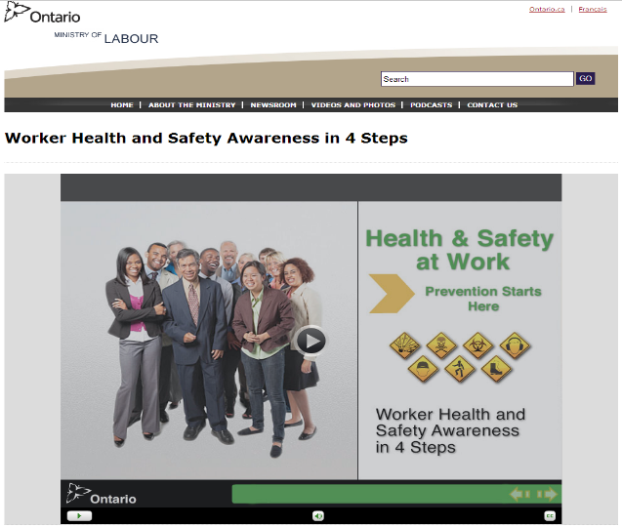
Week #4 – Online Work
myCareer System:
login into the system
find any job, save and upload the posting to Moodle
Read and Review:
Safety in the Workplace PowerPoints (provided on Moodle)
Complete:
Worker Health and Safety Awareness Certificate

